Slide 1
SPRINT REVIEW PRESENTATION
Continuous Integration Pipeline using Jenkins & Docker
General Purpose AI Chatbot Application (OmniBot)
Contributors: Sodanapalli Yashwanth Reddy | Chitmal Anvitha
GitHub Repo: https://github.com/imyashwanthsdp/omnibot

Slide 2
SPRINT REVIEW
Sprint Objectives & Key User Stories
Goal 1: Jenkins SCM Integration
Set up Jenkins server and connect it to GitHub via secure webhooks for automatic push detection.
Goal 2: Pipeline Automation
Create a root Jenkinsfile defining 5 stages: Checkout -> Build -> Test/Validate -> Docker Build -> Result.
Goal 3: Automated Testing & Gates
Execute automated TAP unit tests on every commit; enforce build failure if test assertions break.
Goal 4: Containerization & Tagging
Build Docker images automatically and assign immutable tags (general-chatbot-app:build-${BUILD_NUMBER}).
Goal 5: CI Demonstration
Push a live feature iteration (entertainment intent) and demonstrate end-to-end headless pipeline execution.

Slide 3
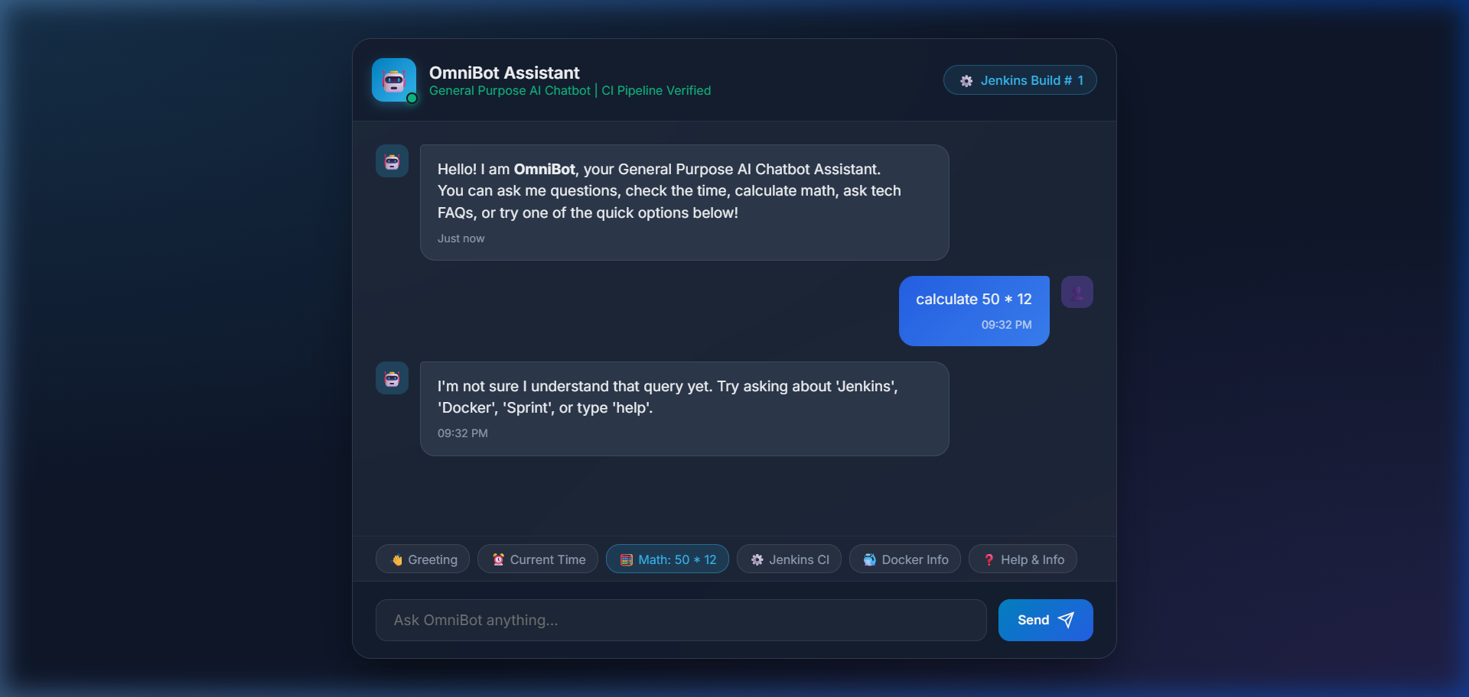
SPRINT REVIEW
OmniBot Architecture & Application Stack
Key Application Modules:
• src/chatbot.js: General Chatbot Engine (Greetings, Math, Time/Date, Tech FAQs, Fallback).
• src/server.js: Express Server exposing REST API (/api/chat & /api/health).
• public/: Responsive Glassmorphism UI with dark mode & action chips.
• test/chatbot.test.js: Automated TAP unit test suite (6/6 tests passing).
• Dockerfile: Alpine-based multi-stage container specification.
• Jenkinsfile: Pipeline as Code defining automated CI workflow.

Slide 4
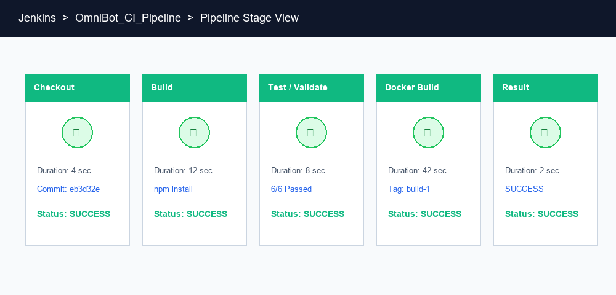
SPRINT REVIEW
Jenkins Pipeline Implementation (5 Stages)
1. Checkout
Clones git commit from origin repository.
2. Build
Installs npm dependencies & runs lint check.
3. Test/Validate
Executes 6 unit tests with TAP output.
4. Docker Build
Builds image tagged general-chatbot-app:build-N.
5. Result
Summarizes pipeline telemetry & verifies image tag.

Slide 5
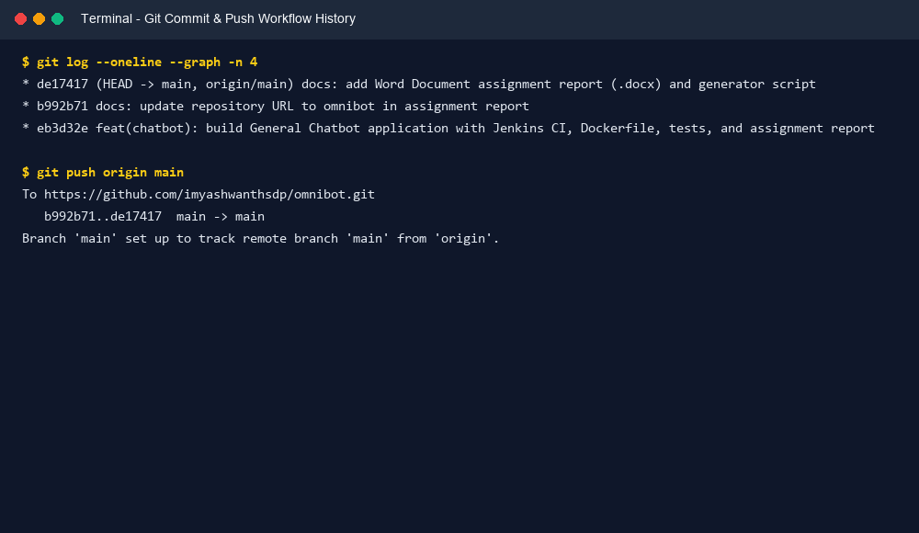
SPRINT REVIEW
Continuous Integration Demonstration & Verification
Feature Modification & Push Workflow:
✔ Code Update: Added 'entertainment' intent (jokes) to chatbot engine.
✔ Git Commit & Push: Committed changes and pushed to GitHub main branch.
✔ Automated Webhook: GitHub notified Jenkins via POST webhook payload.
✔ Pipeline Execution (Build #2): Jenkins automatically triggered Build #2.
✔ Validation Outcome: 6/6 tests passed, created Docker tag general-chatbot-app:build-2.

Slide 6
SPRINT REVIEW
Comparative Analysis: Manual vs. Jenkins CI
Metric: Build & Dependencies
Manual: Manual npm install on local machines prone to environment drift. | Jenkins CI: Automated, centralized build triggered on push in clean Jenkins agent.
Metric: Validation & Testing
Manual: Developer-dependent; tests frequently skipped under tight deadlines. | Jenkins CI: Automated TAP test execution on every commit; blocks broken builds.
Metric: Docker Container Tagging
Manual: Inconsistent manual tags (test1, v2). Risk of broken deployments. | Jenkins CI: Immutable automated tags (general-chatbot-app:build-${BUILD_NUMBER}).
Metric: Error Identification
Manual: Defects caught late during manual QA or production deployment. | Jenkins CI: Instant feedback within 2 minutes of push with exact failure context.
Metric: Human Intervention
Manual: High manual touch required for building, testing, packaging, tagging. | Jenkins CI: Zero human intervention post git-push. Completely automated.

Slide 7
SPRINT REVIEW
Team Contributions & CI/CD Roadmap
Individual Contribution Split:
Sodanapalli Yashwanth Reddy:
• Chatbot Engine & Express API Server
• Multi-stage Dockerfile & Alpine optimization
• Declarative Jenkinsfile & SCM Pipeline
• Git version control & GitHub push operations
Chitmal Anvitha:
• Web Chat UI (HTML/CSS/JS) with Glassmorphism
• Automated TAP unit test suite (6/6 passing)
• Jenkins server credentials & GitHub Webhooks
• Comparative matrix analysis & documentation
Roadmap to Full CI/CD Extension:
🚀 1. Docker Registry Push: Push built images to Docker Hub or Amazon ECR.
🚀 2. Staging Deployment: Deploy container to staging Kubernetes cluster using Helm.
🚀 3. Automated E2E Smoke Testing: Run Cypress/Playwright integration tests against staging.
🚀 4. Production Canary Release: Zero-downtime production deployment with automated rollback on failure.

